Slide 1


Maverik Store Forecasting Model
Group 7: Rachel Butterfield, Heber Jenson, and Justin Hamilton
Notes:
Good Evening,
We are Group 7, comprised of Rachel Butterfield, Justin Hamilton, and myself Heber Jenson. Tonight, we are pleased to share with you the results of our efforts over the past semester’s capstone project for the University of Utah and in conjunction with Maverik. Let’s get started.

Slide 2
Presentation Overview
Business Problem
Modeling Approach
Recommend Model & Results
Future Analysis
Business Value
Notes:
Our presentation will go over the following topics. We will first review the business problem, discuss our modeling approach, report on the final recommended model and its results, provide recommendations for further analysis, and conclude with the business value of our efforts.

Slide 3


Business Problem
Notes:
Maverik is expanding rapidly, with an annual growth rate of 30 new sites. As a business, they want to maximize the return on Investment (ROI) for these new stores and track the sites’ performance. To do this, Maverik challenged us to develop a model that can accurately provide a year's worth of four daily target metrics and update predictions as new data becomes available. Target metrics included Daily Food Sales, Daily Inside Sales, Daily gallons of Unleaded Fuel sold, and daily gallons of diesel fuel sold.
The development of such a model would provide Maverik with a data-driven approach that would enable them to closely monitor the performance of new stores, make informed decisions, and promptly address any underperforming outlets.
Over the past few months, our team has worked hard to develop such a model for Maverik.

Slide 4
Modeling
Eight models were tested
Simple Average
Linear Regression
SARIMA
ARIMA
Exponential Smoothing
XGBoost
Neural Network (LSTM)
Prophet
Notes:
As a team, we tested a total of eight models to find the most accurate model for Maverik to use to address their business problem. Models included a simple average, linear regression, SARIMA, ARIMA, Exponential Smoothing, XGBoost, a Neural Network utilizing (LSTM), and Prophet.

Slide 5
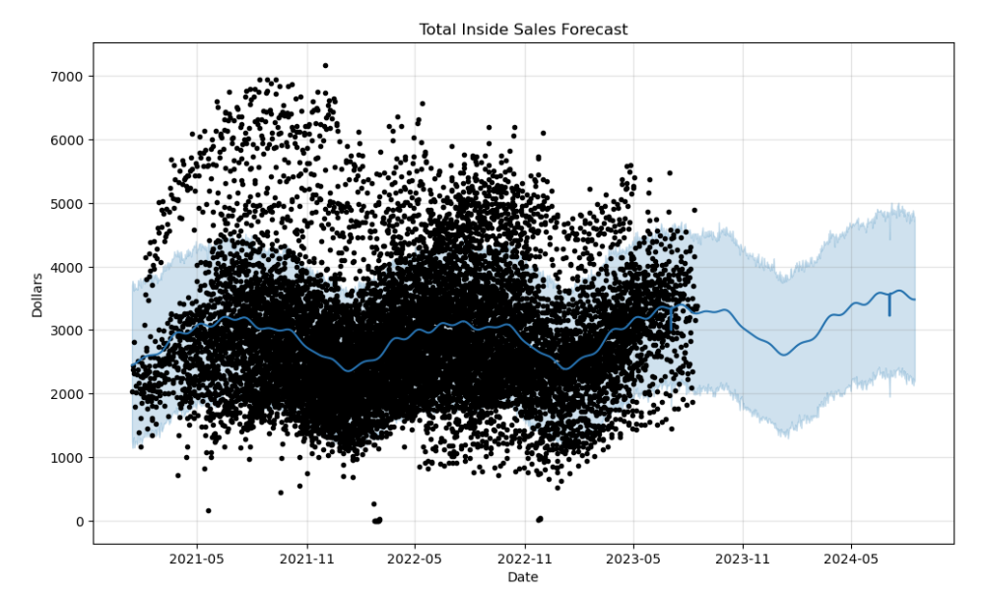
Why the Prophet Model?
Trains on 2.5 years' worth of data
Predicts 365 days into the future
Captures daily, monthly, yearly, and holiday seasonality
Notes:
Of the eight models tested, the final model we recommend for Maverik is the Prophet model. The Prophet model has multiple advantages, including the capability to train on all site training data covering a two-and-a-half-year period at once, a feature not possible for other modeling techniques, the ability to capture a variety of seasonalities, including holidays, and its overall predictive performance. I’ll now turn the time over to Racheal to discuss the Prophet model’s performance in more depth.

Slide 6
Model Performance Metrics
MAE ((Mean Absolute Error)
RMSE (Root Mean Squared Error)
MAPE (Mean Absolute Percentage Error)
RMSPE (Root Mean Square Percentage Error)
RAE (Relative Absolute Error)
RRSE (Root Relative Squared Error)
MASE (Mean Absolute Scaled Error)
Notes:
Rachel

Slide 7
Model Performance Metrics
Using cross validation, the Prophet model produced the following results:
Inside Sales
2 week predicted RMSE - 997
3 week predicted RMSE - 979
6 month predicted RMSE – 930
Food Service
2 week predicted RMSE - 362
3 week predicted RMSE - 339
6 month predicted RMSE – 333
Diesel
2 week predicted RMSE - 2,534
3 week predicted RMSE - 2,131
6 month predicted RMSE - 2,199
Unleaded
2 week predicted RMSE - 935
3 week predicted RMSE - 1,018
6 month predicted RMSE - 1,040
Notes:
Rachel

Slide 8
Model Performance Metrics
MAPE(errors as a percentage) – as close to 12% from actuals when testing for individual stores
MASE(compares error performance against a basic Naïve model) –
Cross validation: up to 26% improvement
Testing for individual stores: up to 17% improvement
Notes:
Rachel

Slide 9
Analytic Results of Model
Overall -
Significant improvement to current Maverik Model
Lower error rate
Up to 26% increase in accuracy for predicting sales vales
Weaknesses –
Performance decreases for stores with extremely high or low target values
Notes:
Rachel

Slide 10
Future Recommendations
Notes:
Justin

Slide 11


Macroeconomic Effects
Notes:
Justin

Slide 12
Store Locations
Macroeconomic Effects
Notes:
Justin

Slide 13
Integrate Model with Current Technology
Store Locations
Macroeconomic Effects
Notes:
Justin

Slide 14

Business Value of this Model
Marketing
Finance
Operations
Management
Notes:
Justin
4 Pillars to Business
- Marketing
- Finance
- Operations
- Management

Slide 15

Marketing: Learn where and how sales could increase
Notes:
Justin
4 Pillars to Business
- Marketing
- Finance
- Operations
- Management

Slide 16

Finance: See which stores have the highest revenue growth opportunity
Notes:
Justin
4 Pillars to Business
- Marketing
- Finance
- Operations
- Management

Slide 17

Operations: Anticipate the supply needed to match the demand for each store
Notes:
Justin
4 Pillars to Business
- Marketing
- Finance
- Operations
- Management

Slide 18

Management: Anticipate earnings of Maverik stores to inform shareholders of growth to the Maverik brand
Notes:
Justin
4 Pillars to Business
- Marketing
- Finance
- Operations
- Management

Slide 19


Business Value of this Model
Notes:
Justin
4 Pillars to Business
- Marketing
- Finance
- Operations
- Management

Slide 20

Fuel to Maverik’s Big Adventure

